Slide 1
PNEUMONIA DETECTION
PARTICIPANTS:
PRAJWAL
PARTH
SANIYA
HRUSHIKESH
RUPESH
PRATIKSHA
Project by g5 group
Dypiemr, akurdi

Slide 2
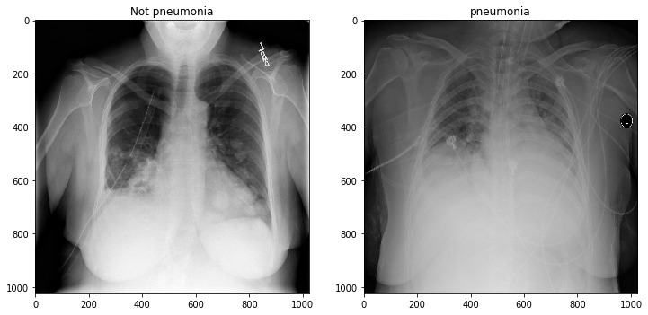
Introduction
A fast, inexpensive and reliable method to determine the type of pneumonia
We have developed machine learning model for classification of pneumonia based only on X-RAY scan of the chest
89-90% accuracy
Traditionally, doctors do the X-ray of the patient’s chest then try to determine the cause with the help of it. If they fail to do that, they would ask the patient for more time consuming and expensive tests like microbial culture and sputum.

Slide 3





The Problem
Time
Financial
Death count
Cause
Diagnosis
Time is crucial in identifying type of pneumonia
Expensive medical test costs like microbial culture and sputum
The amount of deaths due to pneumonia is decreasing year on year. However the death count still remains significant.
Take X-ray of the patient’s chest then try to determine the cause
One of the major problem doctor’s encounter during diagnosis of pneumonia is identifying the type of pneumonia

Slide 4

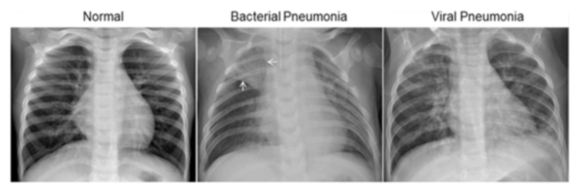


Solution
Faster Results
Accuracy
Cost Effective
Faster result help reduce important time for patient’s health
It has accuracy over 90 % which is enough to get clinically approved
Less cost means everybody can access it at minimal or no cost at all
A HIGH ACCURACY ML MODEL

Slide 5
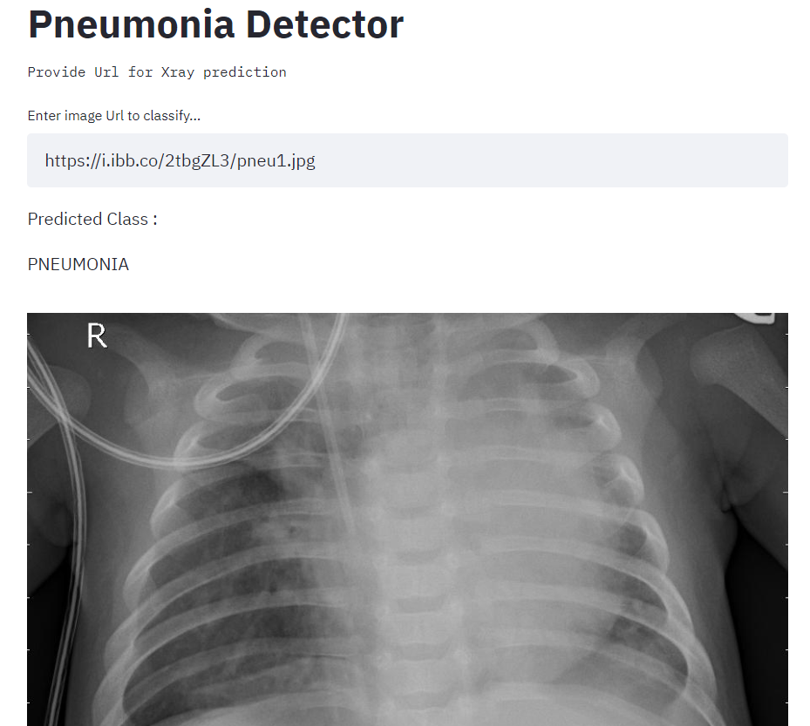



Unique
First to Market
Web app means no installation
Detector is new to market and has huge potential and accuracy
Web-App
Based on EFFICIENTNETB0
Deployed using - Streamlit
Tested
Authentic
Around 1000 images makes accuracy higher
Testing around some x rays showed 90 % accuracy

Slide 6
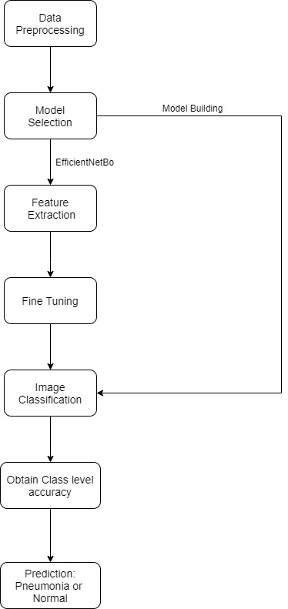
Working
For this Model we have built our own models as well as used efficientNetb0
High accuracy achieved by EfficientNetBO
Scaling up with fine tuning to better suit the problem.
Using softmax activation to get the prediction probabilities of each class.

Slide 7
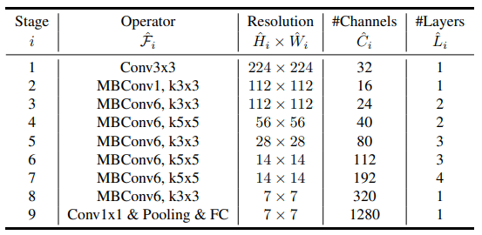
EfficientNet can be considered a group of convolutional neural network models.
The EfficientNet model group consists of 8 models from B0 to B7, with each subsequent model number referring to variants with more parameters and higher accuracy.

Slide 8
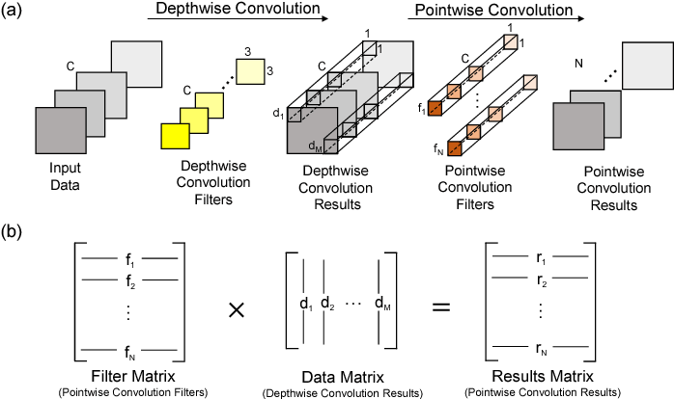
Depthwise Convolution + Pointwise Convolution: Divides the original convolution into two stages to significantly reduce the cost of calculation, with a minimum loss of accuracy.
Inverse Res: The original ResNet blocks consist of a layer that squeezes the channels, then a layer that extends the channels. In this way, it links skip connections to rich channel layers. In MBConv, however, blocks consist of a layer that first extends channels and then compresses them, so that layers with fewer channels are skip connected.
Linear bottleneck: Uses linear activation in the last layer in each block to prevent loss of information from ReLU.

Slide 9
The main building block for EfficientNet is MBConv, an inverted bottleneck conv, originally known as MobileNetV2. Using shortcuts between bottlenecks by connecting a much smaller number of channels (compared to expansion layers), it was combined with an in-depth separable convolution, which reduced the calculation by almost k² compared to traditional layers. Where k denotes the kernel size, it specifies the height and width of the 2-dimensional convolution window.

Slide 10
Insights
Pneumonia-Xray-ML-Model

Slide 11


Business Model
Although this model is created for social impact with no interest in making money, for it to be deployed in mass scale would need some external help and hence elaborating on its business model.
Research
Finance
Invest
A High accuracy is already achieved but still a bit of more research and it would be perfect
Requires almost no money except the internet access or very little when deployed globaly
Requires a very less investment than any other high maintenance devices

Slide 12
Resources
The data for the chest Xrays for this project was provided by Mendeley.com
Citation : Kermany, Daniel; Zhang, Kang; Goldbaum, Michael (2018), “Labeled Optical Coherence Tomography (OCT) and Chest X-Ray Images for Classification”, Mendeley Data, V2, doi: 10.17632/rscbjbr9sj.2
The resources which we accessed all throughout this project were all open-sourced.

Slide 13



Thank You
machinelearning.g5@gmail.com
https://share.streamlit.io/hrushi11/pneumonia_x-ray_ml_model/main/app.py

